Slide 1
Optimization of Word Meaning Search
Guided By: Pratiksha Dehade 141081042
Prof. V.K Sambhe Pratik Sharma 141080036 Akash Kadel 141080041

Slide 2
Introduction
Reading has always been a top list hobby worldwide. Be it conventional way of reading hard copies or advanced way of reading books online.
Although the number of readers reading books online have substantially increased over the enhancement of technology, it has been found out that 80 percent of the total population still prefer reading hard copies of a matter rather than its content surfing over the net.
So even if we have to come up with a idea of revolutionizing the reading experience we need to pave our way towards hard copy reading targeting most of the world’s population. Once the we achieve an active foothold on the physical affair then we can success-fully embed the same into online reading encounters.

Slide 3
Elasticsearch
Elasticsearch is used for many use cases like analytics store, auto complete, spell checker, alerting engine, and as a general purpose document store; Full text search is one of it.
It is a robust search engine that provides a quick full text search over various documents. It searches within full text fields to find the document and return the most relevant result first.

Slide 4
An inverted index consists of a list of all the unique words that appear in any document, and for each word, a list of the documents in which it appears. Inverted index is the most commonly used method for FTS (Full Text Search).
The inverted index searches the relevant document by mapping the term to its containing document. In the dictionary the terms are sorted which results in quick search.

Slide 5
The following example elaborates the searching using Elasticsearch. Consider these documents to be indexed with the contents in it.
Document1: “Elasticsearch is fast” Document2: “Elasticsearch is efficient” Document3: “Elasticsearch offers high speed”

Slide 6
Now to create the inverted index for the above documents, the contents of each document is split into separate words.
After then, the lists of unique words, the document ids in which they are contained and the word frequency list are generated. So the inverted index generated for the above documents would be below:

Slide 7
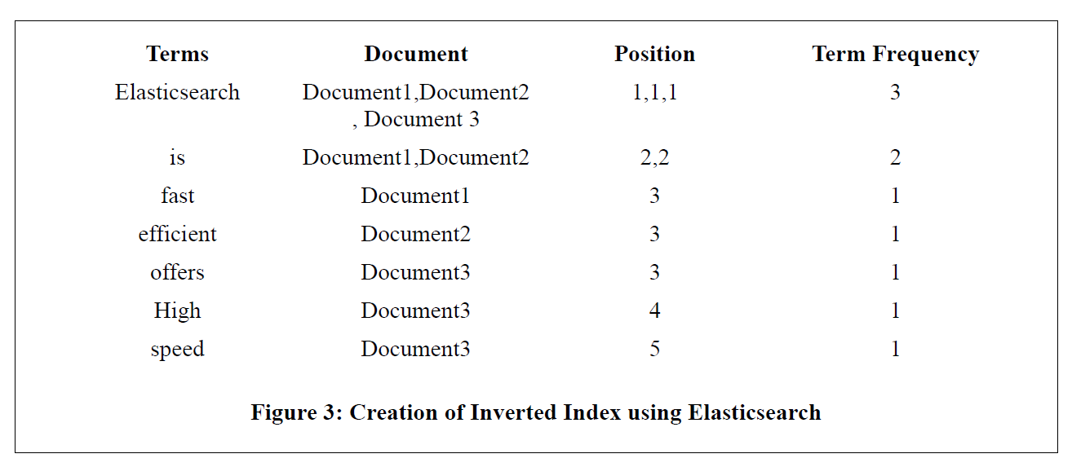
Example of an ElasticSearch index

Slide 8
The frequency effect
Reading is a coordinated execution of a series of processes which involve word encoding, lexical access, assigning semantic roles, and relating the information contained in a sentence to earlier sentences in the same text and the reader’s prior knowledge (Just and Carpenter, 1980)
Successful comprehension of texts depends on the readers’ semantic and syntactic encoding abilities (Marks et al., 1974), as well as their vocabulary knowledge in the language (Laufer & Ravenhorst-Kalovski, 2010; Nation, 2006).

Slide 9
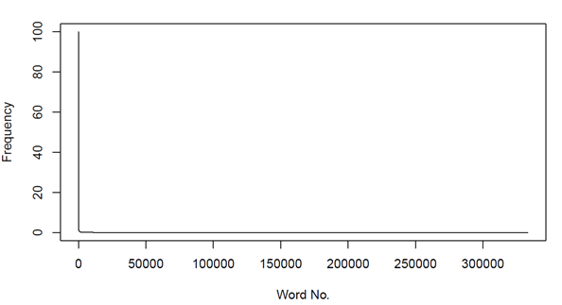
The abrupt change in frequencies

Slide 10
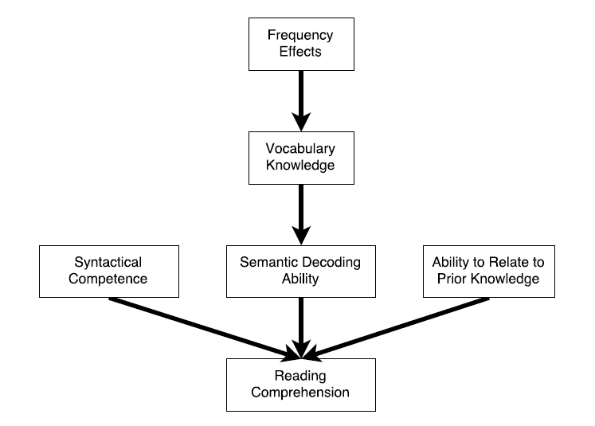
Frequency effect on reading comprehension

Slide 11
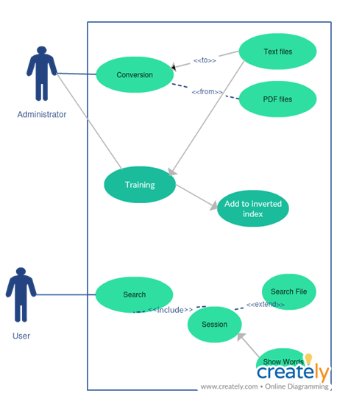
The Use Case of the system

Slide 12
Conversion of files
Once we have the text files ready, we use them to extract the words and add them to the InvertedIndex. Let us create a context to understand the whole process. 1. We extract each word from the text files and store it in a Python Dictionary. While we do so, we also keep on recording the position of each word. We will later know how would that help.
2. These words are then stored in the MongoDB database in such a way that all the occurrences of the word in particular book are stored as a separate document

Slide 13
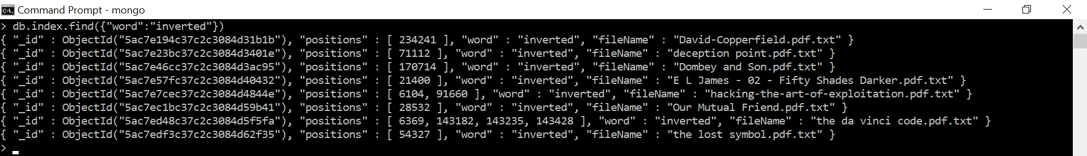
Our version of Inverted Index
{ "_id" : ObjectId("5ac7d655c37c2c06f443a682"), "positions" : [ 2128, 2596, 4187, 10016, 10795, 13894, 18624, 24666, 35002, 37568, 39870 ], "word" : "eye", "fileName" : "1- Stormbreaker.pdf.txt" }
A sample of query for the word “inverted”

Slide 14
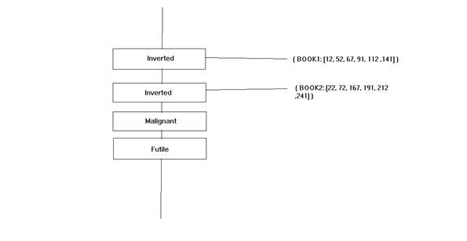
Structure of Index

Slide 15
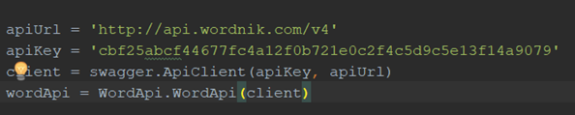
Performing a search
Use the Wordnik API to search for the meanings of the words

Slide 16
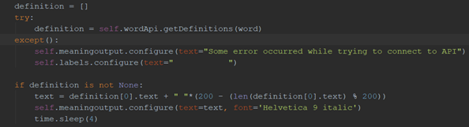
Getting the definitions

Slide 17
Determining the Book
When the user opens up the application for the first time, they are presented with a paragraph in the english language and are made to read it. The time(T) in minutes that they took to read the text is recorded and is used to determine the reading speed of the user. If there are say W words in the text, the reading speed of the user(R) is given as: R=W/T
Word1 word2 word3 ………………. word4 word2
D1 = t1 * R

Slide 18
Use set intersection to determine the book
The definition of the set that we use:
SET1 = { x | distance(W1,W2) = D1 and W1 & W2 ϵ x }
We go forward in the same fashion narrowing down our set of books until we remain with only one element in the set.

Slide 19
Word difficulty
There are many aspects that determine the difficulty of the word which include context, number of syllables and the frequency of the word.
While it’s difficulty to determine the context of the words we can determine the frequency with ease.
The frequency accounts for 0.6 correlation with word difficulty. Hence, it could prove to be good metric

Slide 20
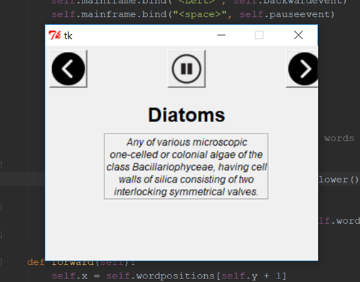
Displaying the words

Slide 21
UI Features
Adjusts as per the user
User can pause and move back and forth through the words
The words are cached for better performance using multiple threads

Slide 22
Result and Discussion
A standalone application to aid book readers
Other implementations
Future Scope

Slide 23
Any questions?
THANK YOU

